Slide 1
Advanced Databases
Distributed Databases
William Clifford
William.clifford@ncirl.ie
04/12/23

Slide 2
Overview
Introductory Concepts
Advantages and disadvantages of Distributed Database Management Systems (DDBMS).
Functions of DDBMS
Distributed Database Design
Transparencies in DDBMS

Slide 3
Introduction
Computer networks promote a decentralised mode of work.
This approach mirrors the organisational structure of many companies:
Logical distribution of function into divisions, departments, projects etc.
Physical distribution of organisation into sites, offices, plants, factories etc.

Slide 4
Introduction
Database System Evolution
Each unit defines and maintains its own data
Centralised Database Systems: data is defined and administered centrally under the control of a single DBMS.
Distributed Database Management Systems (DDBMS): data can be accessed at a set of distributed sites.

Slide 5

Introduction
Distributed databases have been developed to reflect organisational structures:
Data in all units is accessible.
Data is stored in proximity to the locations where it is most often used.
Should improve the shareability of data and the efficiency of data access.
Should help resolve the islands of information
problem

Slide 6
Concepts
Distributed Database
A logically interrelated collection of shared data (and a description of this data), physically distributed over a computer network.
Distributed DBMS
Software system that permits the management of the distributed database and makes the distribution transparent to users.

Slide 7
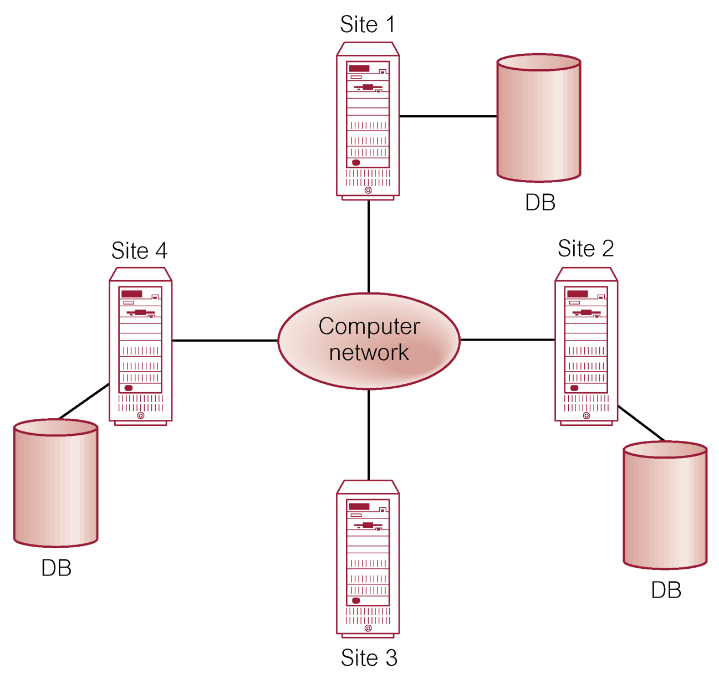
Concepts
Distributed Database Consists of:
A logical database split into a number of fragments.
Each fragment is stored on one or more computers under the control of a separate DBMS.
The computers communicate over a network

Slide 8
Concepts
Distributed Database Management Systems:
Users access the distributed database via applications:
Local applications: do not require data from other sites.
Global applications: do require data from other sites.
DDBMS have at least one global application

Slide 9
Concepts
Distributed Database Management Systems Characteristics:
Collection of logically-related shared data.
Data split into fragments.
Fragments may be replicated.
Fragments/replicas allocated to sites.
Sites linked by communication network.
Data at each site under control of DBMS.
DBMS’s at each site can handle local applications autonomously.
Each DBMS participates in at least one global application.

Slide 10
Distributed DBMS
Not necessary for every site to have its own local database

Slide 11
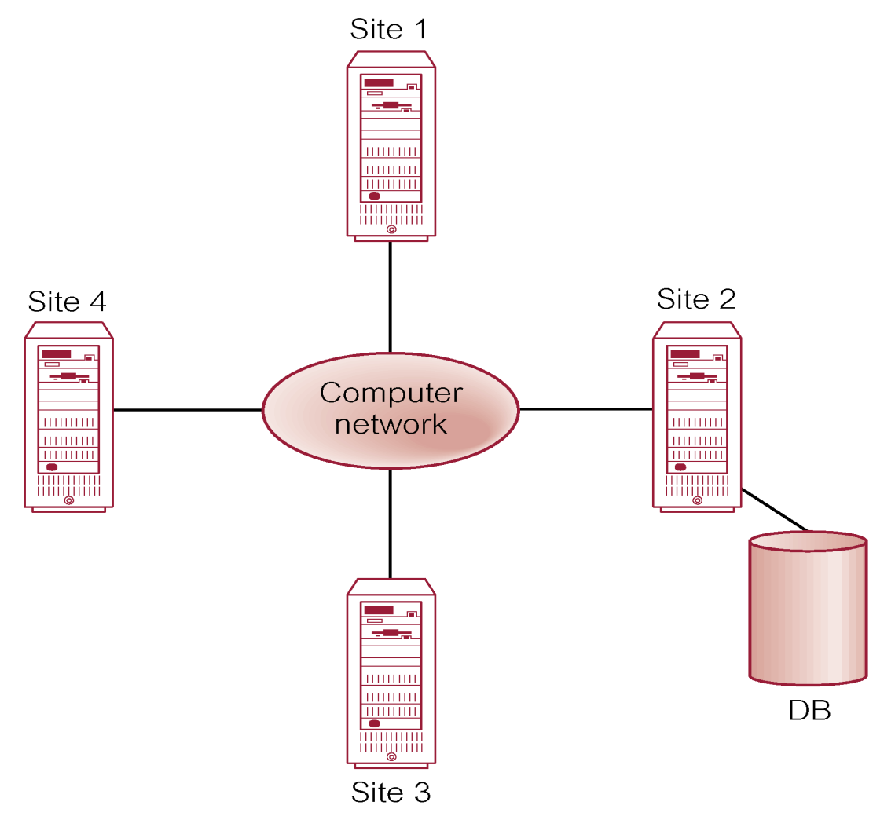
Distributed Processing
A centralised database can be accessed over a computer network.

Slide 12
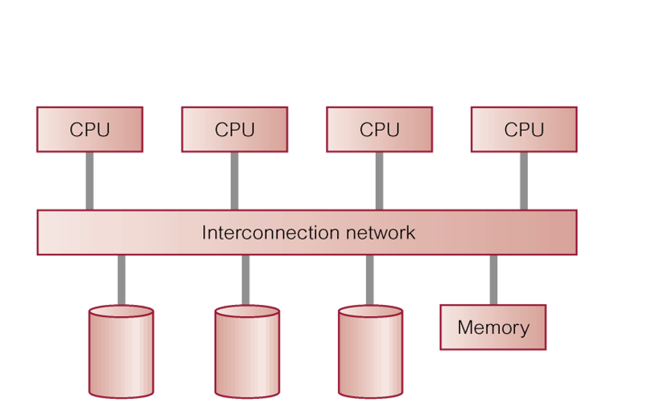
Parallel DBMS
DBMS’s can be designed to run across multiple processors and disks.
This can execute tasks in parallel, to improve performance.
Based on the premise that a single processor system can no longer meet the requirements for cost-effective scalability, reliability, and performance.
Parallel DBMS’s link multiple, smaller machines to achieve the same throughput as a single larger machine, with greater scalability and reliability.

Slide 13
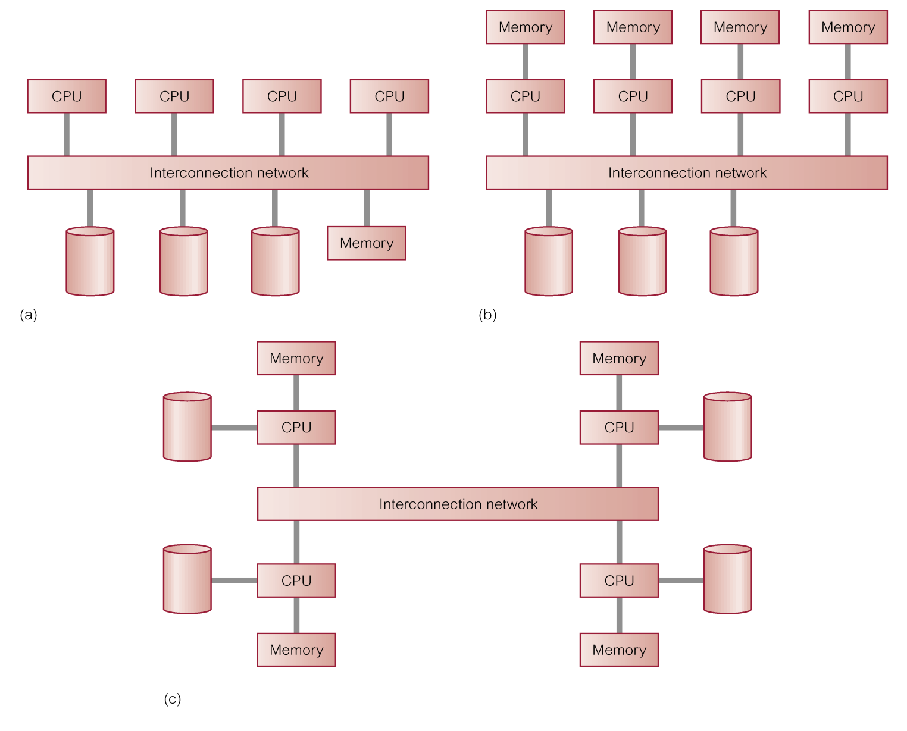
Parallel DBMS
Architectures for parallel DBMS’s are:
Shared memory
Shared disk
Shared nothing

Slide 14
DDBMSs advantage and disadvantages
Advantages:
Reflects organizational structure.
Improved shareability and local autonomy.
Improved availability
Improved reliability
Improved performance
Economics (a large system vs many small).
Modular growth
Disadvantages:
Complexity
Cost (manpower needed)
Security (network connections)
Integrity control
Lack of standards
Lack of experience
Database design more complex
Notes:
Advantage
3) no single point of failure
4) Data is replicated across the system
5) Data physically located at the sites it is most often used
Disadvantage:
Security: data transferred over the network often, requests can be made to retrieve data and it can be lost. Some nodes sending requests may never hear back if the network loses the request/response

Slide 15
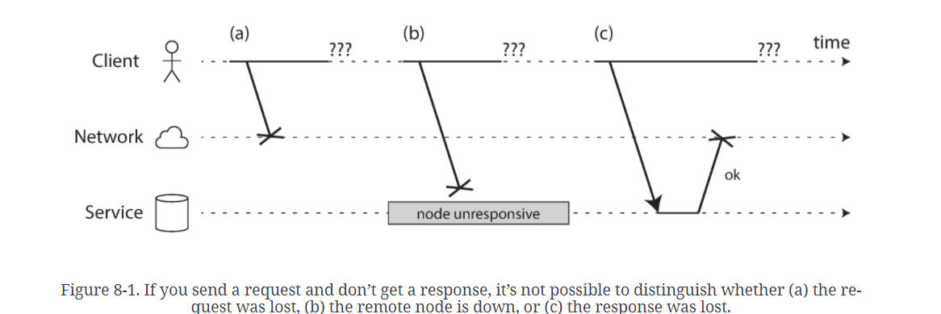
DDBMSs - a bit more on disadvantages
Unreliable Networks
Issues with waiting for a response from a sent packet:
May have been lost.
Waiting in a queue to be delivered later.
Remote node may have failed.
Remote node temporarily stopped responding but will respond later.
Remote node processed request, but response lost in network.
Usually, timeouts are used for detection of a fault.

Slide 16
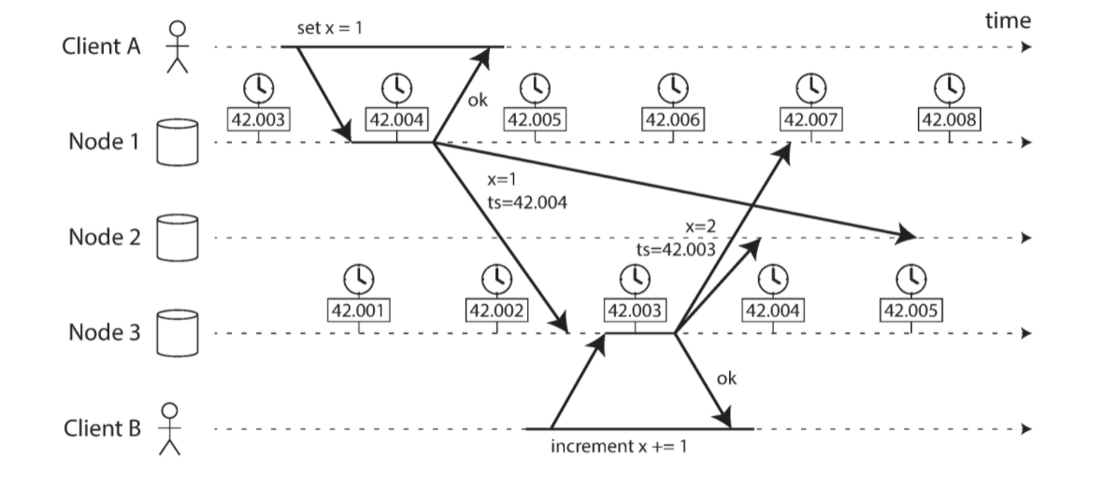
DDBMSs – could timestamps save us?
Each machine has its own clock – a hardware device, usually a quartz crystal oscillator.
These devices are not totally accurate, so each machine has its own notion of time (how long a second is).
Machines can synchronize to a network time protocol (NTP) that allows the computer clock to adjust to a time according to a group of servers.
Quartz clocks drift. They can even vary depending on temperature.
NTP synchronization is only as good as the network delay.
Notes:
Keeping track of writes to a distributed file system using replicas is difficult since we can’t depend that the time an update is set on one computer would match the same relative time on another. No solid concept of time to enable a “happens before” condition writing.

Slide 17
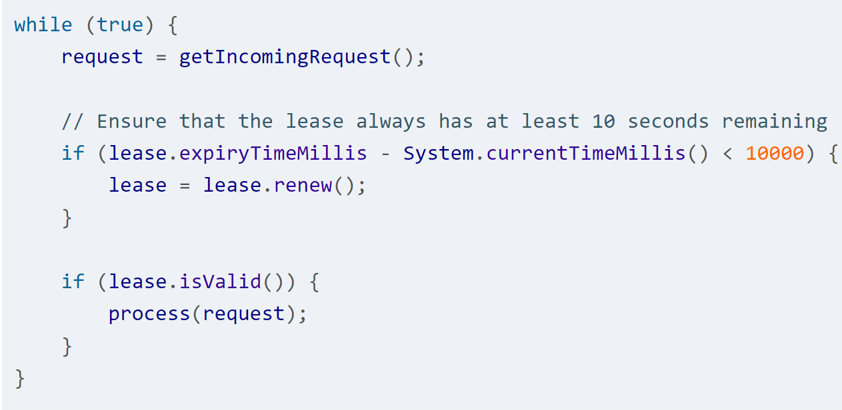
DDBMSs – could timeouts save us?
Consider where a node in a distributed system needs to know if it is currently a leader. How will it know this?
Optionally use a lease (like a lock) it has for some set time.
The node acquires a lease with a timeout.
Only one node can hold a lease at a time.
Leaders renew/release the lease after the timeout period.
If the node stops renewing, then another node takes over.

Slide 18
Types of DDBMS
Homogeneous DDBMS:
All sites use the same local DBMS product (maybe MySQL)
Easier to design and manage.
Similar to a centralised DB, but over a distributed system.
Provides incremental growth and allows for increased performance.
Heterogeneous DDBMS:
Sites may run different DBMS products, with possibly different underlying data models.
Occurs when sites have implemented their own databases and integration is an after-thought.
Translations required for:
Different hardware
Different DBMS products
Typical solution is to use gateways.

Slide 19
Functions of a DDBMS
Expect DDBMS to have at least the same functionality as a DBMS.
Additionally:
Extended communication services
Extended data dictionary
Distributed query processing
Extended concurrency control
Extended recovery services

Slide 20
Distributed Database Design
Three key issues:
Fragmentation: relations may be divided into a number of sub-relations, which are then distributed.
Allocation: each fragment is distributed and stored at site with optimal distribution.
Replication: DDBMS may maintain a copy of fragments at several sites.

Slide 21
Fragmentation
Definition and allocation of fragments is carried out strategically to achieve:
Locality of reference.
Improved reliability and availability.
Improved performance.
Balanced storage capacities and cost.
Minimal Communication Costs.
Notes:
Reliability: if a node hosting a fragment fails it may be found as a copy somewhere else. Or other parts of the same type of data is partitioned on a different node.
Availability: if a data table you’re interested in is currently locked by another program then you must wait. However if the data is partitioned across multiple nodes then you can possibly access the data you’re interested in immediately so long as it is occupying a different partition.

Slide 22
Data Allocation
Four alternative strategies regarding placement of data:
Centralized: a single database and DBMS stored at one site with users distributed across the network.
Partitioned (or fragmented): Database partitioned into disjoint fragments each fragment assigned to one site.
Complete replication: maintaining complete copies of the database at each site.
Selective replication: combination of partitioning, replication, and centralization

Slide 23
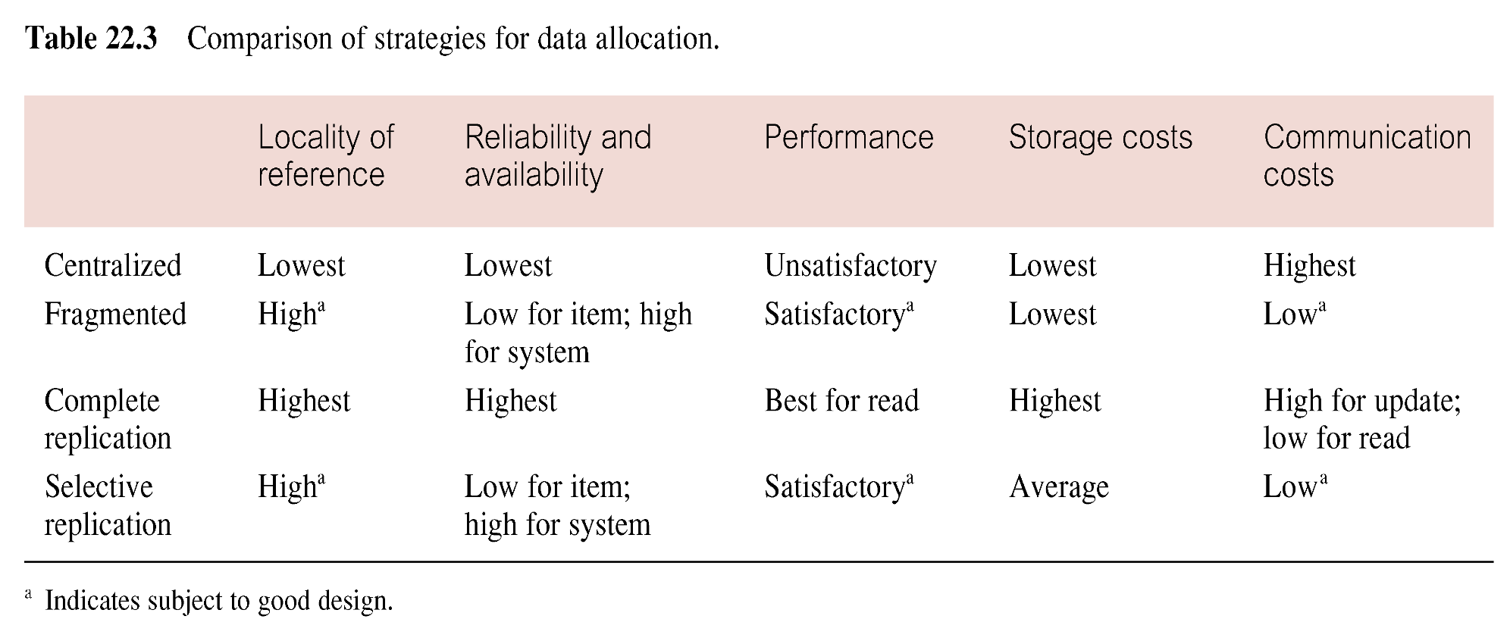
Comparison of Data Distribution Strategies

Slide 24
Why Fragment?
Usage: applications work with views rather than the entire relations.
Efficiency:
data stored close to where it’s used.
Data not needed by local applications not stored.
Parallelism: transactions can be divided into subqueries operating on separate fragments.
Security: data not required by local applications is not stored and therefore not available to unauthorized users.
Disadvantages
Performance: apps pulling data from many fragments will be slower. Network delays, or detecting system crashes.
Integrity: referential integrity will be more difficult. Communicating updates to all replicas may be slow/inconsistent.

Slide 25
Fragmentation
Breaking the database into logical units which may be assigned for storage at various sites.
Without replication each relation, or portion of the relation, is stored at only one site.
Simplest model is to store different relations at different sites.
Sometimes this is not sufficient and parts of relations should be stored.
There are 3 main types of data fragmentation for database relations:
Horizontal Fragmentation
Vertical Fragmentation
Hybrid Fragmentation

Slide 26
Fragmentation
A)
B)
C)
Horizontal Fragmentation
Vertical Fragmentation
Hybrid Fragmentation

Slide 27
Horizontal Fragmentation
Typically tuples that belong to a given horizontal fragment are identified by selection query:
E.g. an employee relation for a company with employees in London and New York.
We could fragment so that records for employees in Department D1 and D3 are stored in New York sites (where they work).
Department D2 are stored in London where they work.
We can reconstruct the original employee table with a union operation.

Slide 28
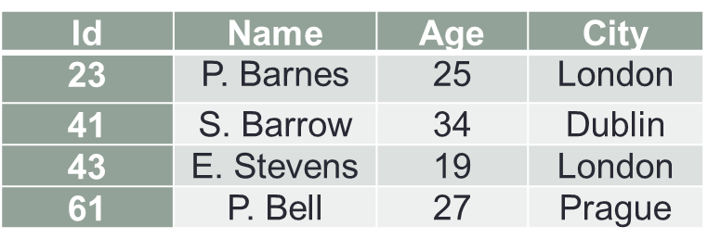
Horizontal Fragmentation - Example
Consider the following table of data:
Show how the data in this table can be fragmented horizontally so that the records associated with conditions
City = “London”
City NOT = “London”
…are stored in distinct table fragments.

Slide 29
Horizontal Fragmentation - Example
A relation (table) may be divided up into a number of sub-relations called fragments which are then distributed
Fragment 1
Id | Name | Age | City
23 | P. Barnes | 25 | London
43 | E. Stevens | 19 | London
Fragment 2
Id | Name | Age | City
41 | S. Barrow | 34 | Dublin
61 | P. Bell | 27 | Prague

Slide 30
Vertical Fragmentation - Example
Horizontal fragmentation can lead to hotspots.
A projection of the columns, where we store different attributes of the same tuple at different sites.
We may want the EMPLOYEE relation into two vertical fragments.
The first fragment includes personal information – Name, birth, address, gender.
The second with work-related information –SSN number, salary, DeptNo.
Try drawing out how these tables would transform!

Slide 31

Vertical Fragmentation – another fun Example
Partition 1
C1:00:00:00:10 x=1, y=3
C1:00:00:00:11 x=1.1, y=3
C1:00:00:00:12 x=1.2, y=3
What if hot spots develop?
E.g., a robot with sensor measurements and each measurement is indexed by a timestamp.
A single day is given to each partition.
Problem: Some days might not be recorded. Hot spots develop for days the sensors are used.
Solution: Index first by sensor type (for a partition) and then order by timestamp in that partition.
Partition 2
C2:00:00:00:10 x=1, y=3.5
C2:00:00:00:11 x=1 y=3
C2:00:00:00:12 x=1.2, y=3
Partition 3
C3:00:00:00:10 x=1, y=3
C3:00:00:00:11 x=0.1, y=3
C3:00:00:00:12 x=0.2, y=3
Partition 4
C4:00:00:00:10 x=1.7, y=3
C4:00:00:00:11 x=1.1, y=3
C4:00:00:00:12 x=1, y=3.1

Slide 32
Hybrid Fragmentation
A mixed fragment of a relation consists of a horizontal fragment that is subsequently vertically fragmented, or a vertical fragment that is subsequently horizontally fragmented.
E.g. store the work-related fragments and personal fragments at separate sites, but also save the vertical fragment of the work-related data in New York or Dublin.
We can reconstruct the original with a combination of outer joins and union operations.

Slide 33
Transparencies in DDBMS
Fundamental Principle – the distribution should be transparent to the user:
Implementation details are hidden
DDBMS provide various levels of transparency:
Distribution transparency
Transaction transparency
Performance transparency
DBMS transparency
Full transparency is not a universally accepted objective.

Slide 34
Distribution Transparency - Types
Fragmentation transparency:
User does not know the data is fragmented and may query any table as though it was not.
Location Transparency
Users are unaware of the physical location of the data but are aware there is fragmentation.
Local Mapping Transparency
Users need to know that data is fragmented and where the data is located.

Slide 35
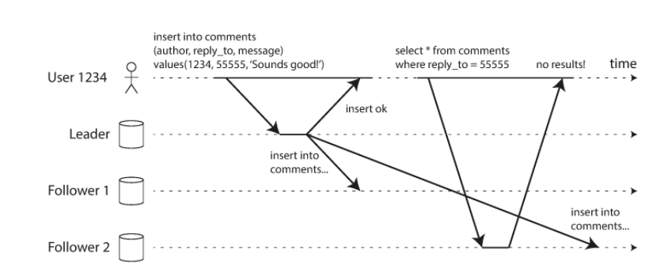
Transaction Transparency
Transaction transparency is a DDBMS ensures that all distributed transactions maintain the database’s integrity and consistency.
Distributed transactions accesses data stores in more than one location.
Each transaction is divided into a set of sub-transactions, one for each site.
Both transactions and sub-transactions must be indivisible.
Transaction management in a DDBMS is complicated in terms of synchronization.
Notes:
Synchronous databases ensure write-leader databases are forced to wait until followers are complete before continuing processing writes.
Asynchronous databases allow the leader to proceed processing queries without confirmation from followers.

Slide 36
Performance Transparency
This requires the DDBMS performs as if it were a centralised DBMS.
There should be no performance degradation due to the distributed nature of the architecture. If anything it should be better.
The DDBMS must also determine the most cost-effective way to execute a request.

Slide 37
Summary
Introductory Concepts
Advantages and disadvantages of Distributed Database Management Systems (DDBMS).
Functions of DDBMS
Distributed Database Design
Transparencies in DDBMS

